Slide 1

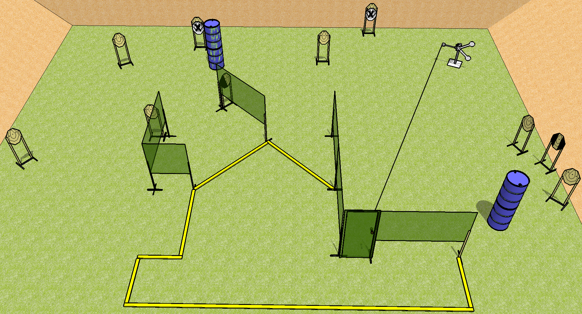
 | Dothan Practical Shooters – USPSA Match Short Fuse Course Designer : Drew Coleman Bay: B3
Round Count 22 rounds 10 IPSC 2 plates
Equipment List Red stitch swinger + activator + door 10 targets (8 + 2NS) 1 tux, 1 left diag
X x

Slide 2
Short Fuse
Written Stage Briefing
Scoring: Comstock Rounds: 22
Targets: 10 IPSC, 2 steel
Handgun start position: feet on X’s, wrists below belt. Handgun is loaded and holstered.
PCC start position: feet on X’s, stock on belt. Loaded carbine is held with both hands, safety on.
Stage Procedure: On the audible start signal, engage targets as they become available from within the shooting area. The plate swinger is activated by the door and remains visible at rest.

